Slide 1
SWING KIDS 2020-2021
Contents:
2) What is Swing? 3)Why Swing? 4) Who is Swing Kids?
5-9) 2020-2021 Executives & Instructor.
11) How to contact us?
12) Join us?
10) 2020-2021 year activities.

Slide 2
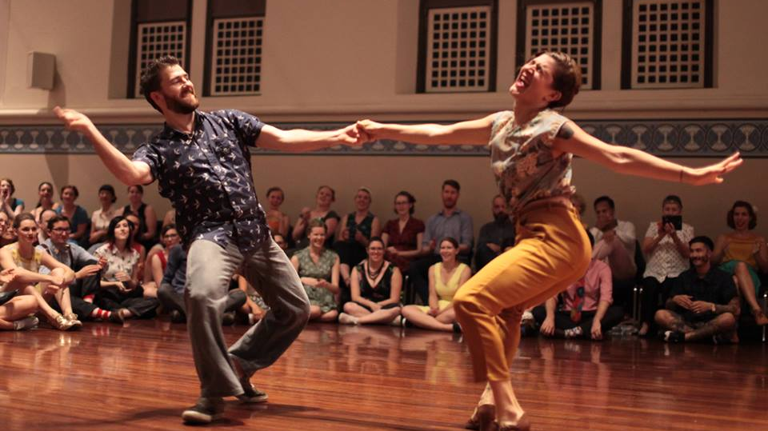
What is Swing?
Swing is a musical characteristic of a certain type of jazz which rhythmical and melodic presence makes you want to dance! Technically, the Swing effect is rendered with the help of syncopations, which are non-binary rhythm variations which give to the music a swinging feel. Let’s Swing!

Slide 3
Why Swing?
Swing brings people together in a joyful social setting facilitating self-expression through body movement and connection with other dancers, all of which to music and rhythms that bring big smile and energy to all who experience it! The art of Swing dancing not only will make you exercise, enjoy a social setting and have you meet wonderful people, develop better consciousness of your body, but it will also stimulate your creativity since it's an improvised dance. It is also highly social, and the swing dance community is very welcoming and warm as a whole.

Slide 4
Who is Swing Kids
The UWO Swing Kids are a fun loving group of students from the University of Western Ontario who meet to Lindy Hop, and Charleston to the songs of Louis Armstrong, Big Bad Voodoo Daddy, Michael Buble, Billie Holliday, Duke Ellington and various other big bands! The club is geared towards people with absolutely NO EXPERIENCE in swing dancing!

Slide 5
Ates Avci - President
I had the chance to learn Swing in my first year through Swing Kids and it was a major part of my first-year experience! Swing to me is freedom, being in the moment and pure joy!!

Slide 6
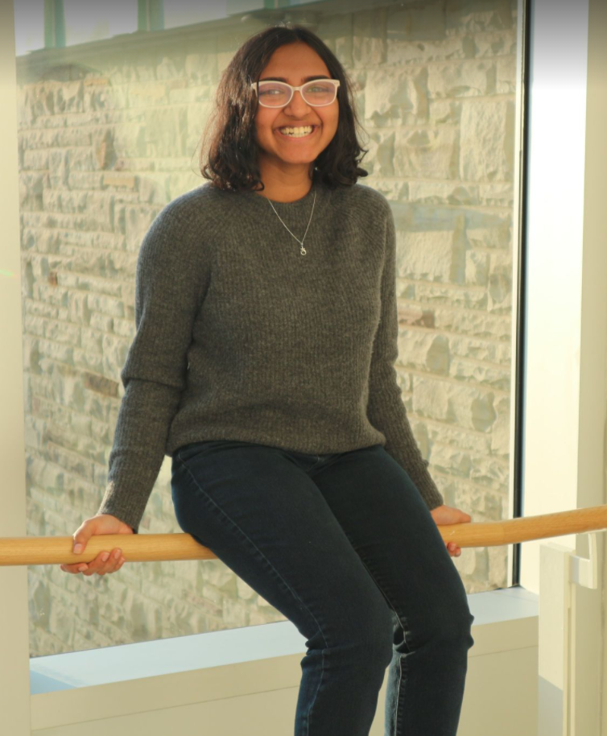
Oviya Ananthakrishnan – VP Events
I learnt about swing dance and joined the club in my first year. It was a great way for me to cope with the academic workload and have some fun!

Slide 7
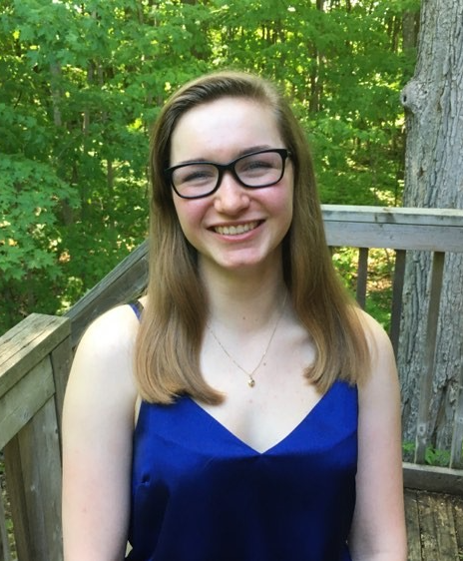
Alyssa Sheri Wiebe – VP Finance
I joined swing kids in first year after being invited out by a friend, and I found it to be a very fun break from classes! It’s a fun and active way to do something a little different, and as one who previously had no dance experience, it is quite easy to get into!

Slide 8
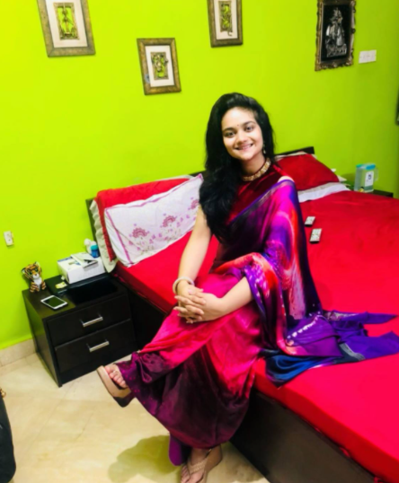
Manasi Saraswat – VP Communications
Hey guys!! My name is Manasi Saraswat and I am a third year Health Sciences student. So as the Vice President for Swing kids I would want to share my idea of Swing dance. I truly believe that Swing dance is so much more than a dance, it is actually a way of life. The music gets stuck in your head and the dance gets stuck in your heart and the whole scene is engraved in your soul and you can just fly. So please do join it and experience the magic yourself. Really hope to see you all soon, Take Care!

Slide 9
Julia Buker – Instructor
Julia started dancing in Calgary, Alberta in February of 2016. What was once something fun to do in her spare time, has turned into an unquenchable passion for everything swing dance. Julia performed with the Calgary based vernacular jazz chorus girl group 'The Sugar Sweets', and she has been to many workshops and exchanges including Stompology, Rhythm Shuffle, PLEX, Round Midnight, Summer Solstice, Meet in the Middle, and AIW, and has taken lessons in Calgary, Victoria, Vancouver, Toronto, Kingston, Ottawa, Rochester (NY), and Buffalo (NY). Julia dances Lindy Hop, Charleston, Blues, and has a particular love of Balboa. She is currently living in London ON after finishing her masters in Vocal Performance. She teaches voice and piano lessons at a private studio, as well as swing dance through Swing London and at the UWO Swing Club.

Slide 10
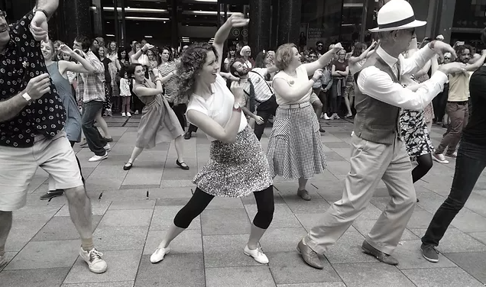
2020-2021 Activities
Unfortunately, we can’t have our usual in-person classes this year with rotating partners due to Covid-19. But! We still plan to have a hybrid system with online videos/meetings and in-person classes to keep the spirit alive!
In-person: To maximize the safety, we’ll ask you to come with your partner or everyone will be assigned one «permanant» partner in the first class to minimize contact. We will also enforce hand sanitizing often and mask usage even if we are dancing outside (possible location till winter) And! We plan to work on Solo Jazz since it is basically dancing to Swing tunes without a partner which is perfect to enjoy Swing and ensure social distancing at the same time!

Slide 11
How to contact us?
Zoom: Visit us at https://westernuniversity.zoom.us/j/94511836031 from Monday to Friday, 10am-4pm,, Meeting ID: 945 1183 6031
If we are not available on zoom, you can always reach one of our executives on facebook or to our facebook group page.
Facebook page: https://www.facebook.com/groups/uwoswingkids
We always post our events on this page, so you might want to join if you want to keep updated!

Slide 12
Join Us?
Our annual membership fee is 10$ which includes all the classes throughout the year! You can join us officially on http://westernusc.ca/clubs/#getstarted .
Hope to see you in-person one day!

